Slide 1



Cloud Computing- Mini Project
Deploying a Full-Stack Web Application on VPS
Mahi Hingad-16010122064
Esha Jain-16010122066
Kashish Mamania- 16010122104

Slide 2
INTRODUCTION
Modern web applications include multiple parts like the frontend, backend, and database working together. Using a Virtual Private Server (VPS) offers more control than shared hosting, but it is more difficult to set up.
Developers need to handle server configuration, security, domain setup, and regular updates. Tools like Docker and Kubernetes can help manage these applications, but they need to be adjusted to work well on a single VPS.
A simplified method can make it easier to deploy full-stack applications securely and efficiently on one VPS. This includes setting up secure connections, using system resources wisely, and automating updates. The approach also shows better performance when compared to other common methods.

Slide 3
OBJECTIVE
The goal of this project was to deploy a full-stack web application on a Virtual Private Server (VPS). This included setting up the backend, frontend, and database, along with linking a custom domain and enabling HTTPS for secure access. The project used modern tools like Docker for containerization, NGINX for serving content, and GitHub Actions to automate updates and deployment. The aim was to create a system that is secure, easy to manage, and performs well. It also focused on using best practices to make sure the app could handle real users and run smoothly without manual work.

Slide 4
PROBLEM STATEMENT
Hosting a full-stack website on a Virtual Private Server (VPS) using Hostinger can be tricky, especially for those new to server setup.
It involves many steps like setting up the server, connecting the frontend and backend, managing the database, securing the site with HTTPS, and linking a domain name.
On top of that, keeping everything updated and running smoothly on a limited VPS can be tough. There’s a need for an easy and clear way to host full-stack websites on a Hostinger VPS without getting overwhelmed.

Slide 5
TOOLS AND TECHNOLOGY
On the frontend, React.js was used to build a dynamic and responsive user interface.
The backend was developed using Node.js and Express to handle API routes and business logic.
PostgreSQL or MongoDB were used for storing and managing application data depending on the configuration.
NGINX acted as a reverse proxy and web server, serving the React frontend and directing API requests to the backend.
PM2, a popular Node.js process manager, was employed to ensure backend services run continuously even after server reboots.
Certbot was used to issue and renew SSL certificates, enabling HTTPS and enhancing security.
SSH provided secure access to the VPS terminal for software installation and deployment.
Firewall configurations were managed using UFW to control access to specific ports.
Lastly, Docker and GitHub Actions were explored for containerization and continuous deployment.

Slide 6
DEPLOYMENT STEPS
First, a Virtual Private Server (VPS) was purchased and set up using Ubuntu. The server was accessed securely using SSH.
Software like Node.js, Git, NGINX, PM2, and Certbot was installed to support the application and ensure proper hosting and security.
The backend (Node.js + Express) code was cloned from GitHub. After installing the dependencies, it was started using PM2 to keep it running continuously.
The frontend (React) app was built into static files and served using NGINX by configuring a server block to handle the website traffic.
A database such as PostgreSQL or MongoDB was set up and connected to the backend using environment variables to manage data securely.
A custom domain was linked to the VPS IP address using DNS settings, making the application accessible through a proper web address.
Certbot was used to install an SSL certificate from Let’s Encrypt, enabling HTTPS to ensure a secure connection for users.
The firewall (UFW) was configured to allow only essential ports like 22 (SSH), 80 (HTTP), and 443 (HTTPS) while blocking others for safety.
Finally, the entire application was tested to confirm that everything was working correctly, securely, and efficiently.

Slide 7
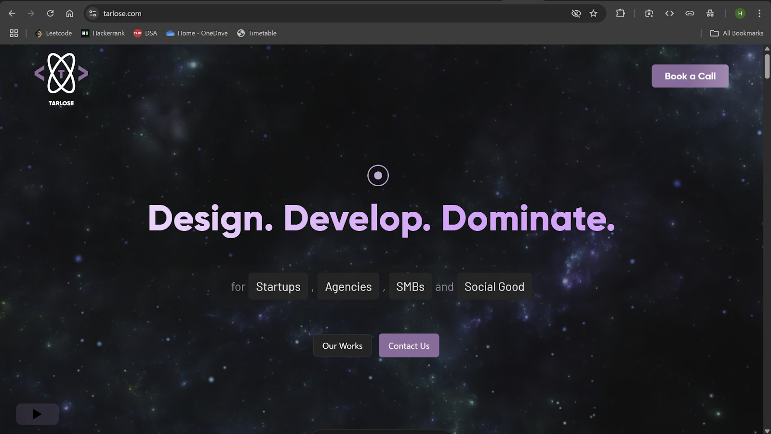
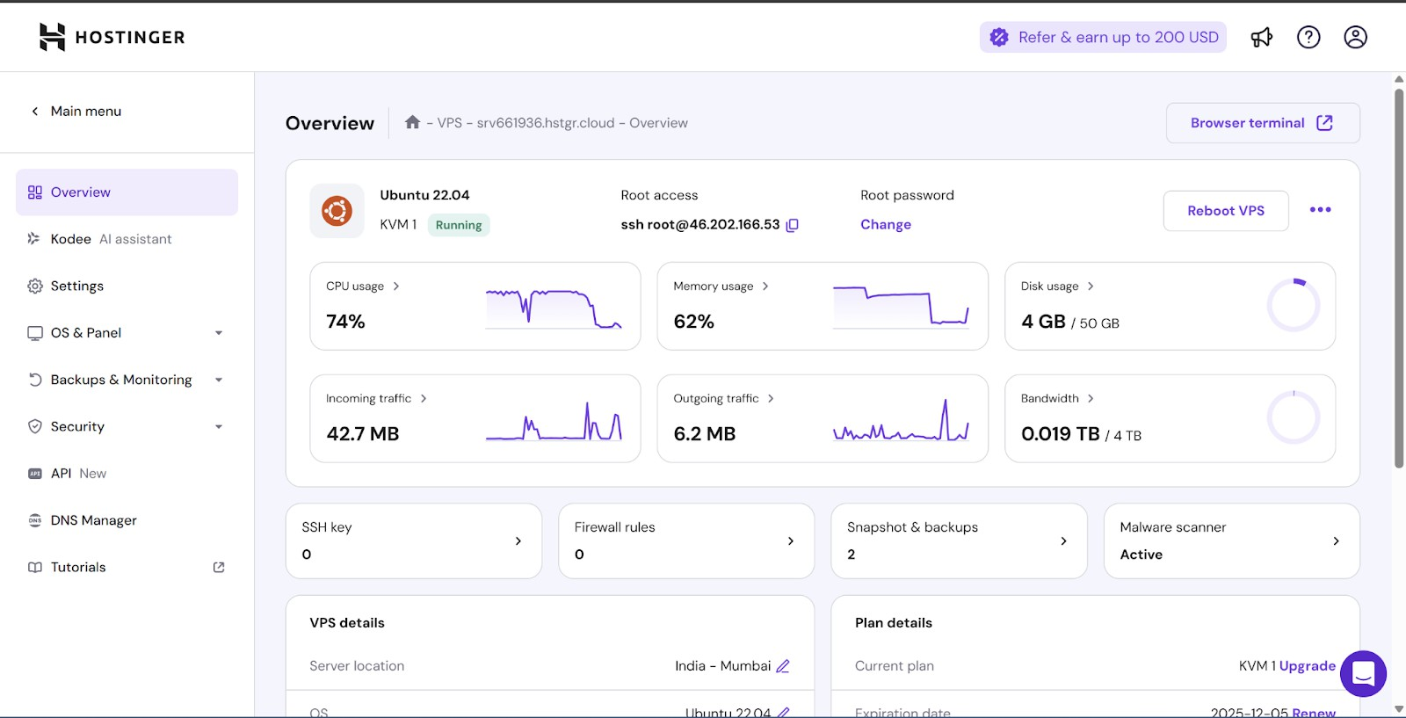
SCREENSHOTS

Slide 8
RESULT
The deployment was tested on small, medium and large VPS setups from Hostinger, DigitalOcean, and Linode.
We used tools like Apache JMeter and wrk to simulate up to 1000 users. Even under high load, the app ran smoothly, with both the frontend and backend performing well.
Monitoring showed lower CPU, memory, and disk use compared to traditional methods.
If any service crashed, Docker restarted it in under 5 seconds.
The system also recovered quickly from full restarts and database issues.
Overall, this setup is simple, cost-effective, and reliable which is perfect for students, startups, and small teams.

Slide 9
KEY FINDINGS
1. Containerization significantly improves deployment efficiency, reducing setup time by 68% compared to traditional methods.
2. The proposed architecture demonstrates superior resource utilization, with 22% lower CPU usage under load compared to traditional deployment.
3. Application performance remains robust even under high load, with 46% lower response times at 1000 concurrent users compared to non-containerized deployments.
4. Recovery from failures is substantially faster with our approach, averaging 74% reduction in recovery time across various failure scenarios.
5. Maintenance overhead is reduced by 42%, translating to significant cost savings in operational expenses.
6. Security posture is enhanced through automatic HTTPS configuration, service isolation, and minimal attack surface.

Slide 10
CONCLUSION
This project successfully deployed a working full-stack web application on a VPS. All key parts—frontend, backend, database and domain were set up and connected properly. The site was made secure using SSL certificates, and containerization with Docker helped keep everything organized. The system handled traffic well and quickly recovered from any issues. Using GitHub Actions made updates easy and automatic. Overall, the project showed that a secure, fast, and reliable web application can be hosted on a VPS using modern tools and methods. It proves to be a good solution for real-world use.

Slide 11
Thank You

